Slide 1
Dashboard mockup slides
Team 4 library

Slide 2
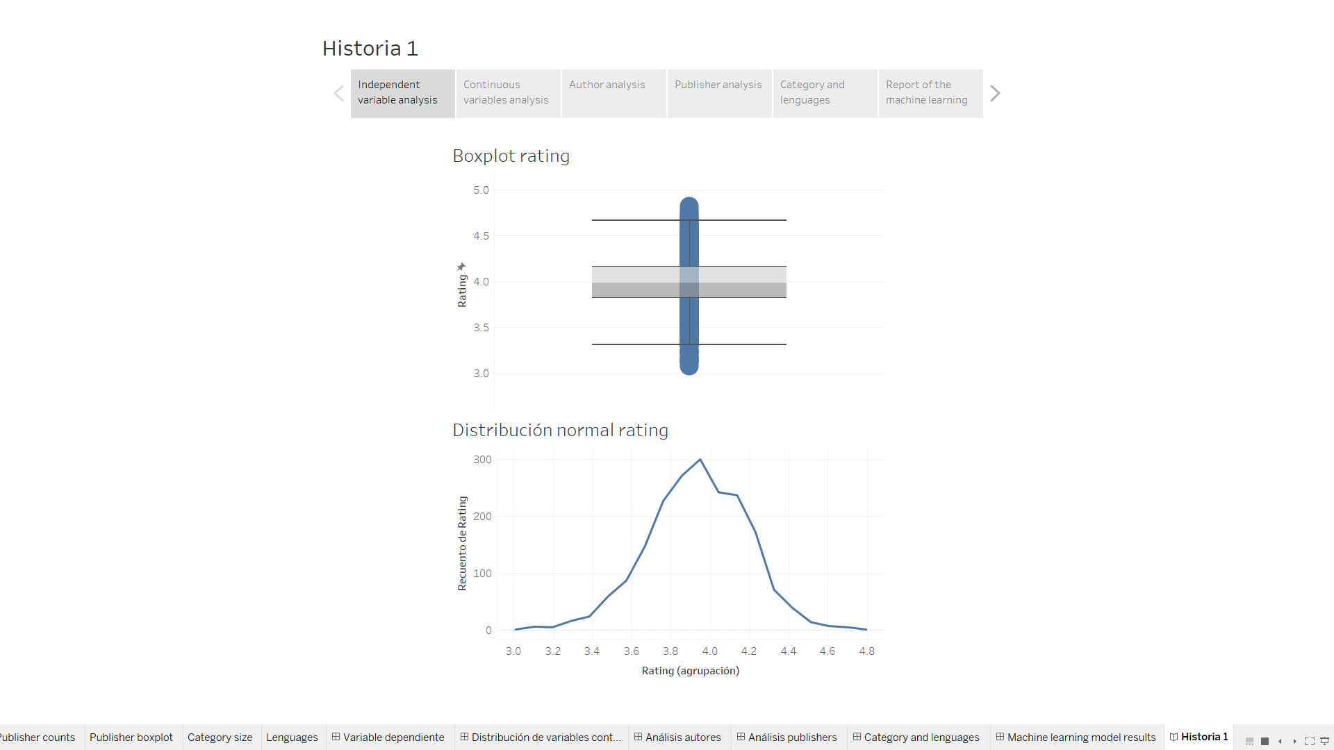
Indepentent variable analysis

Slide 3
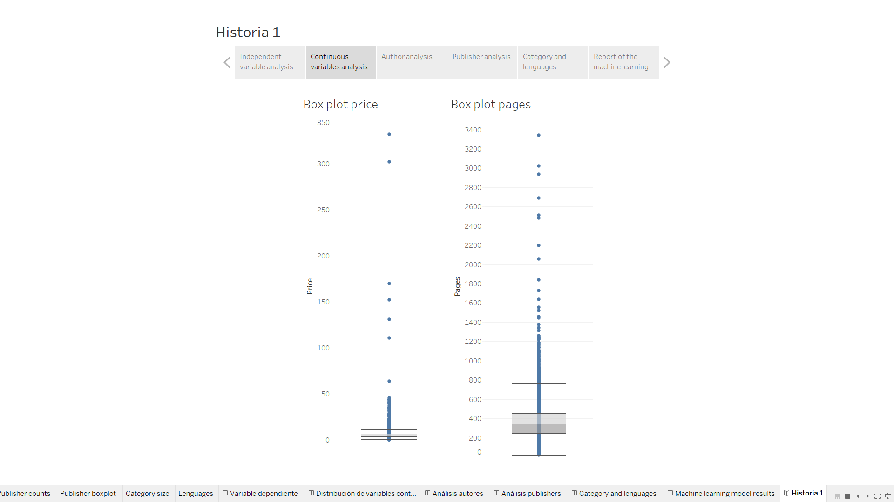
Continuous variable analysis

Slide 4
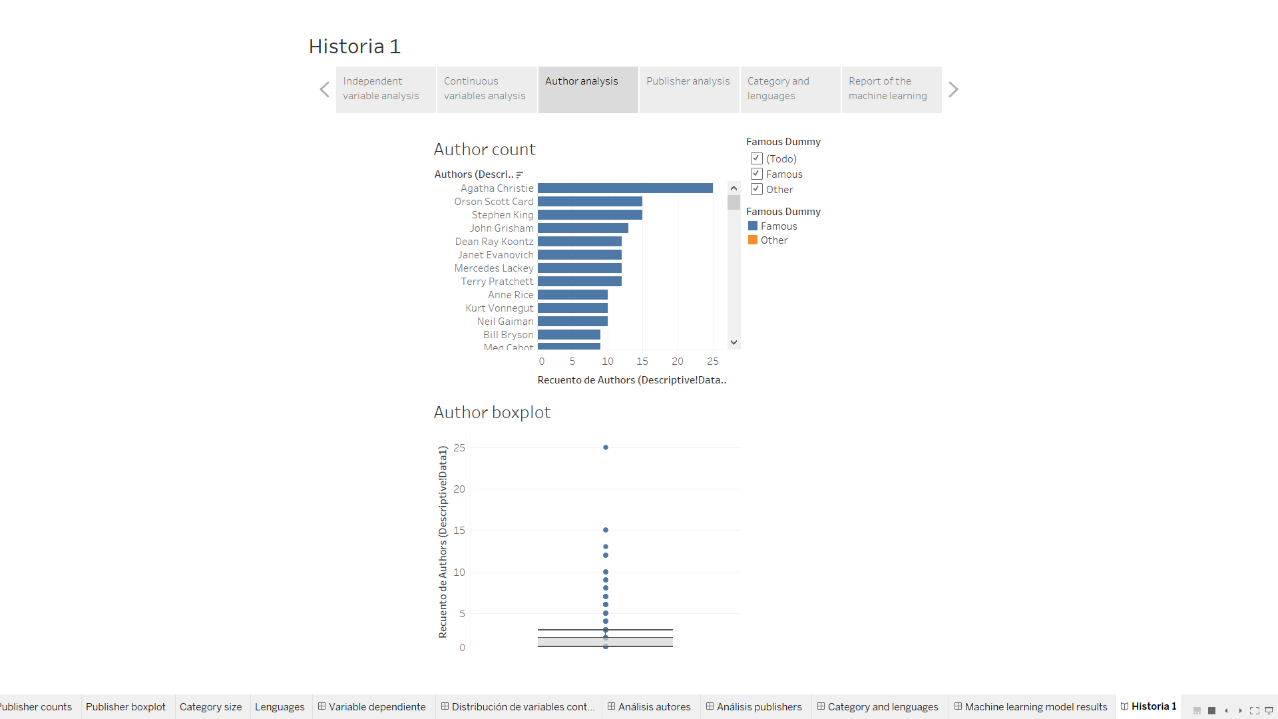
Author analysis

Slide 5
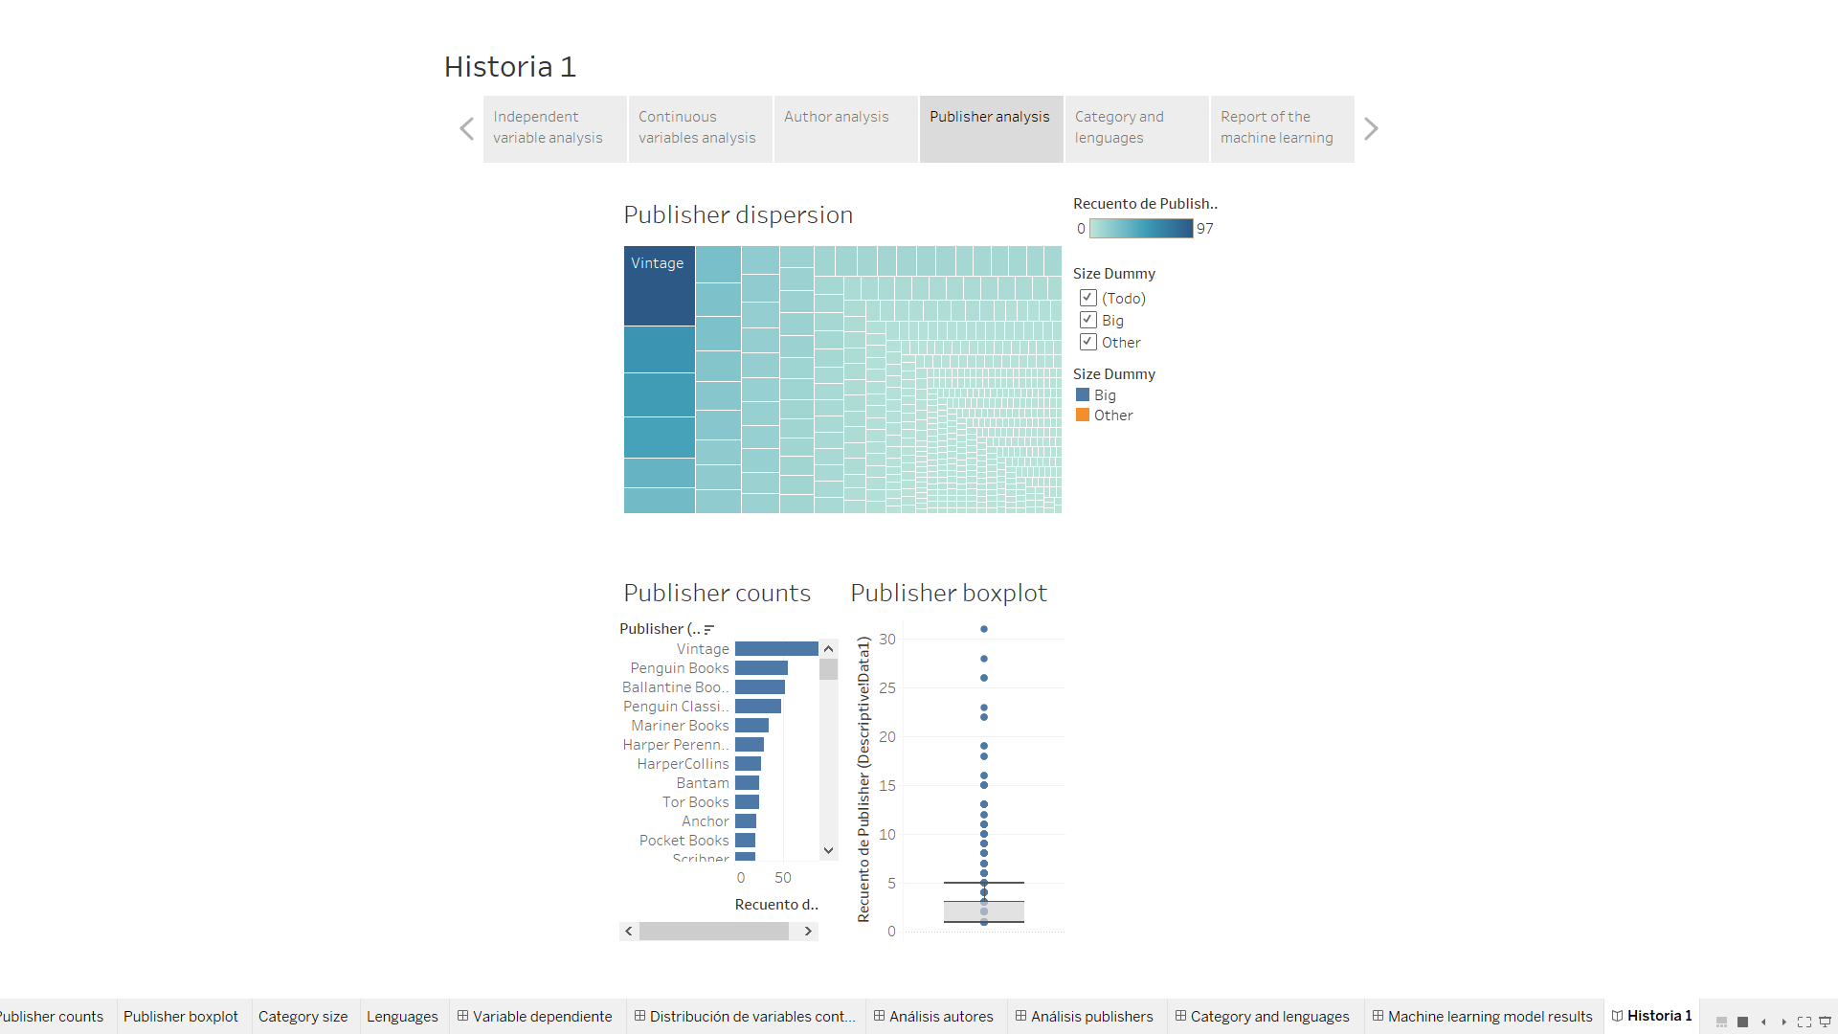
Publisher analysis

Slide 6
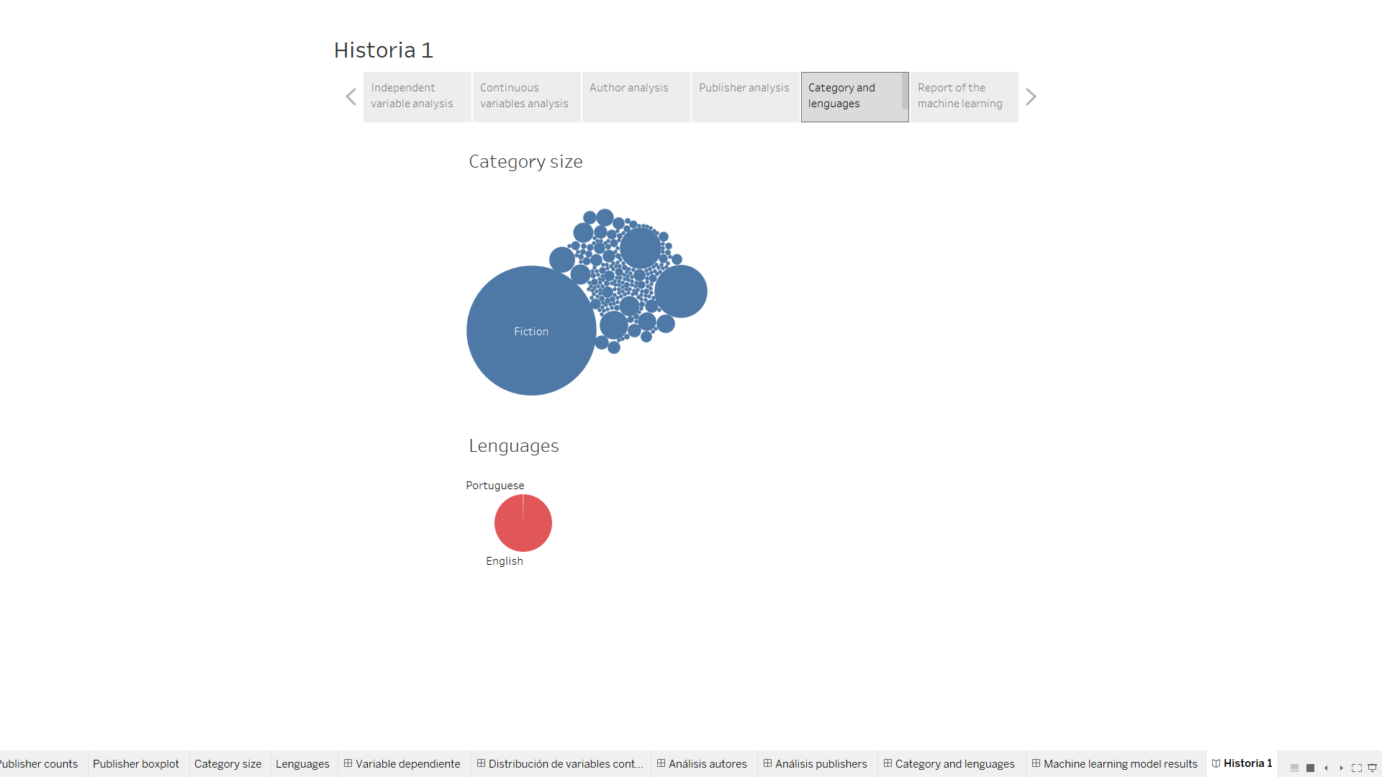
Category and languages analysis

Slide 7
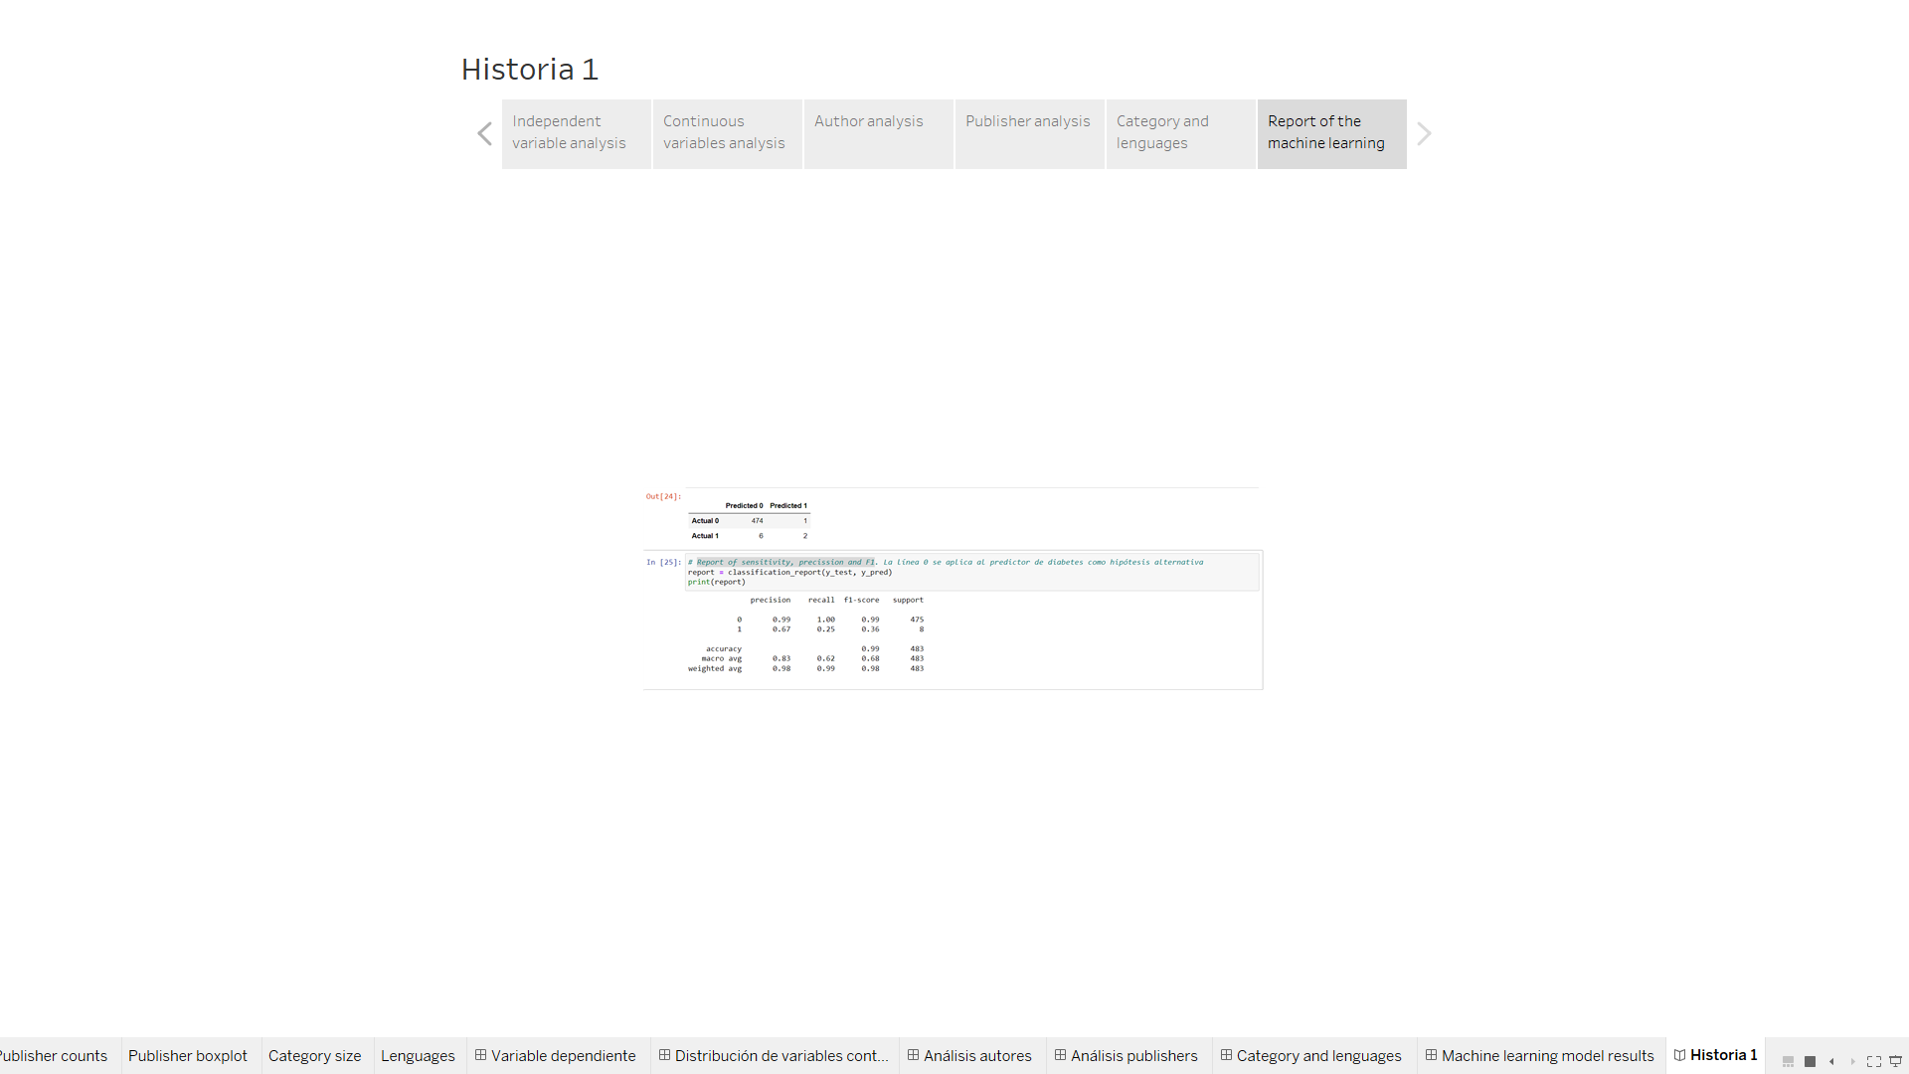
Machine learning report

